Slide 1

R and RStudio

Slide 2
Objectives
Define the R programming language and discuss its application in data science.
Use RStudio packages to experiment with plotting.
R and RStudio

Slide 3

What is R
Statistical programming language
Used for data processing and manipulation
Statistical, data analysis and Machine learning
R is used most by academics, healthcare and the government.
R supports importing data from different sources: Flat files, databases, web, statistical software
R and RStudio

Slide 4
R Capabilities
It is easy to use compared to other Data science tools
Great tool for visualization
Basic data analysis does not require installing packages
R and RStudio

Slide 5
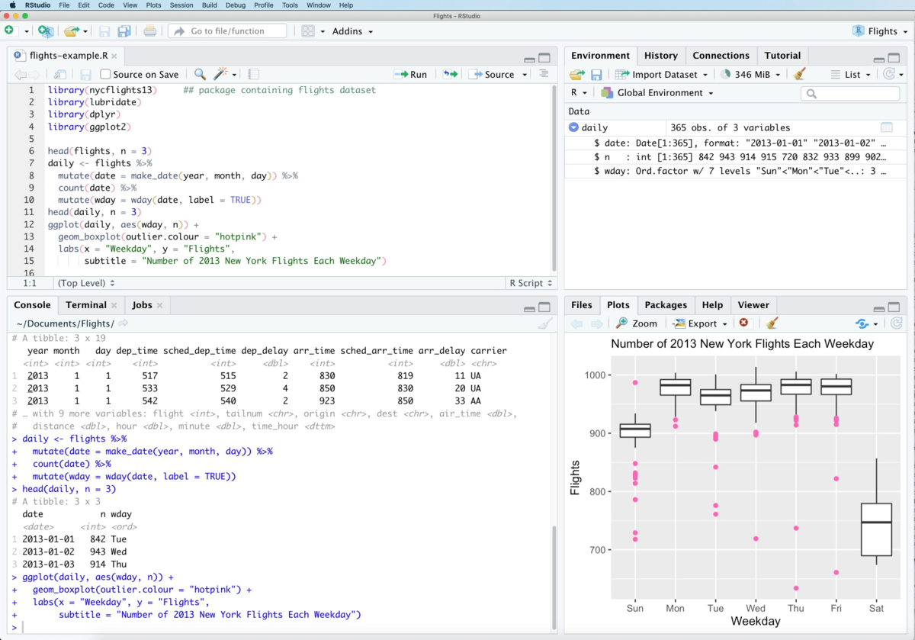
What is RStudio
Rstudio is an Integrated Development Environment( IDE)
It increases productivity in running R programming language
R and RStudio

Slide 6
RStudio elements
Code Editor
Workspace/ history
Console
Plots, file, help
R and RStudio

Slide 7
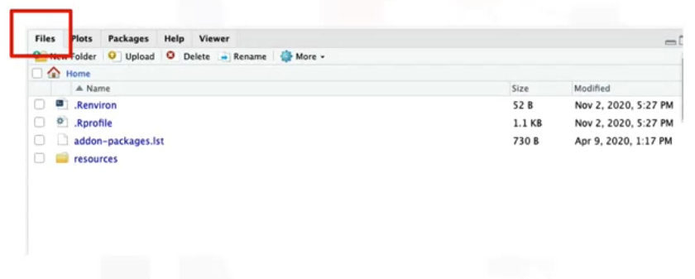
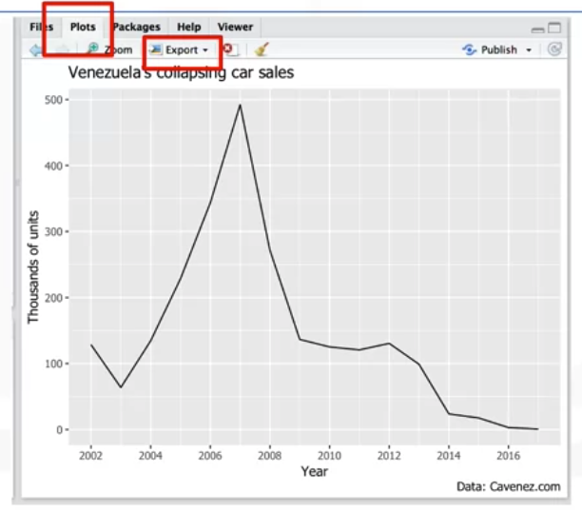
RStudio elements
R and RStudio

Slide 8
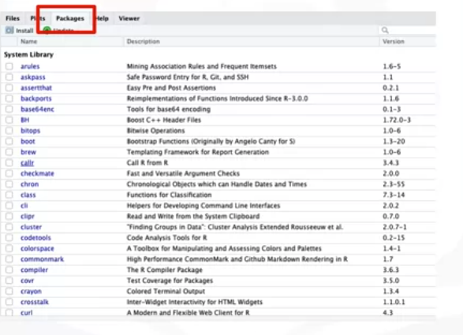
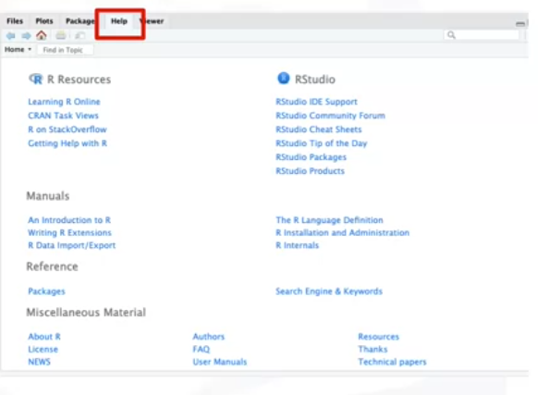
RStudio elements
R and RStudio

Slide 9
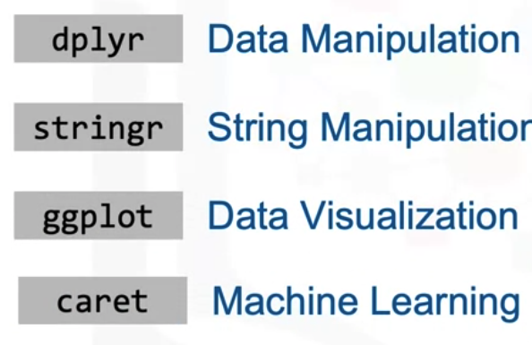
Popular R libraries for data science
dplyr for manipulating data,
stringer for manipulating strings,
ggplot for visualizing data
caret for Machine Learning
R and RStudio

Slide 10
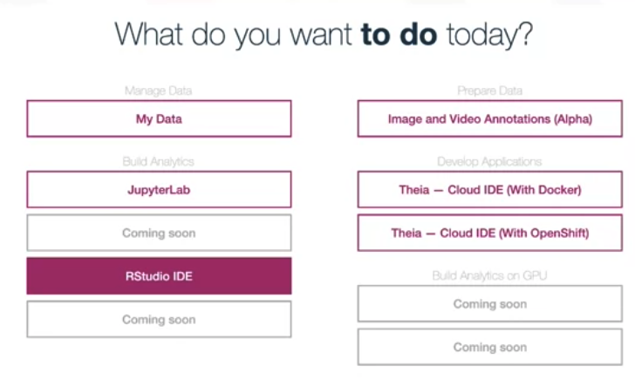
RStudio elements
This virtual lab environment is designed to assist you to easily practice what you learn in the course and skip the need to create an account or download or install anything.
You should now be familiar with: The capabilities of R and its uses in Data Science The RStudio interface for running R codes and Popular R packages for Data Science
R and RStudio

Slide 11
Data Visualization in R
R is a very great tool for data visualization and has different packages.
Some of the popular and top data visualization tools include:
  ggplot which used for data visualizations such as histograms, bar charts, scatterplots etc. It allows adding layers and components on a single visualization.
  Plotly is an R package can be used to create web-based data visualizations that can be displayed or saved as individual HTML files.
R and RStudio

Slide 12
Data Visualization in R
Some of the popular and top data visualization tools include:
  Lattice is a data visualization tool that is used to implement complex, multi-variable data sets. Lattice is a high-level data visualization library; it can handle many of the typical graphics without needing many customizations.
  Leaflet is very useful in creating interactive plots
To install these packages in your R environment, use the install dot packages and the package name command.
R and RStudio

Slide 13
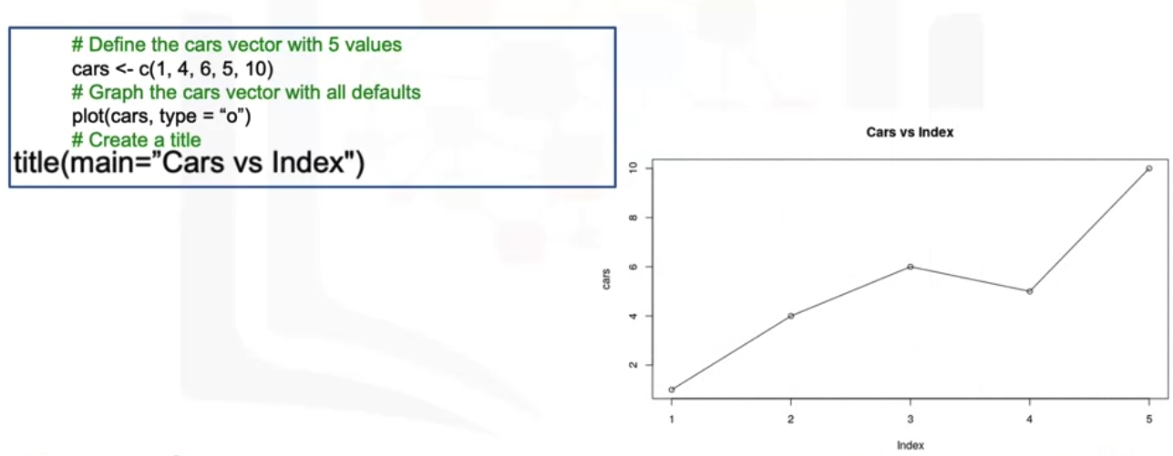
Using the plot function
R also has its own inbuilt functions to create plots and visualization, it is mostly used using the plot function.
For example, the function above is the simplest form of the plot function and it returns a scatterplot of the values vs the index as shown here
R and RStudio

Slide 14
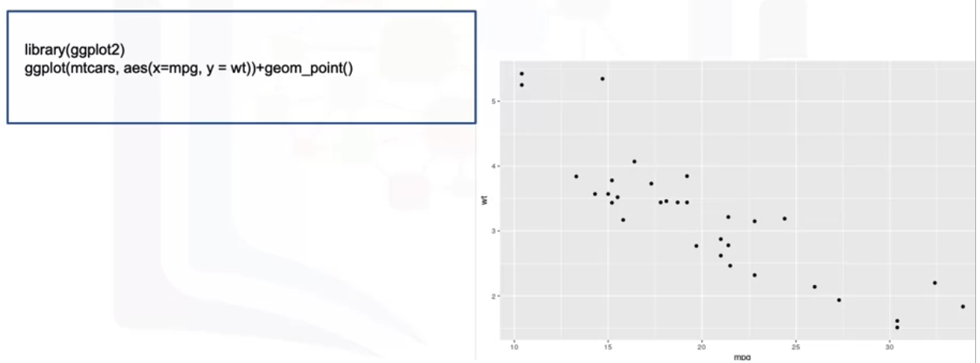
Using ggplot
R and RStudio

Slide 15
Summary
Define the R programming language and discuss its application in data science.
Use RStudio packages to experiment with plotting.
R and RStudio

Slide 16
Q & A
R and RStudio

